Slide 1


ZOO ANIMAL CLUSTRING & CLASSIFICATION
Moran Wang & Rui Wang

Slide 2
Data source and definitions explained
There are 16 variables with various traits to describe the animals. https://www.kaggle.com/uciml/zoo-animal-classification/data
zoo.csv
animal_name
Boolean : hair, feathers, eggs, milk, airborne, aquatic, predator, toothed,
backbone, breathes, venomous, fins, tail, domestic, catsize.
Numeric : legs
class_type: integer values in range [1,7]
class.csv
Class_Number : integer values in range [1,7]
Number_Of_Animal_Species_In_Class Numeric
Class_Type : The actual word description of the class
Animal_Names : The list of the animals that fall in the category of the class

Slide 3
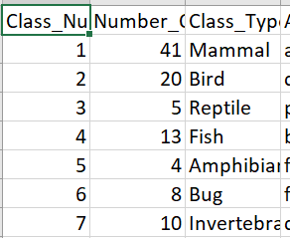
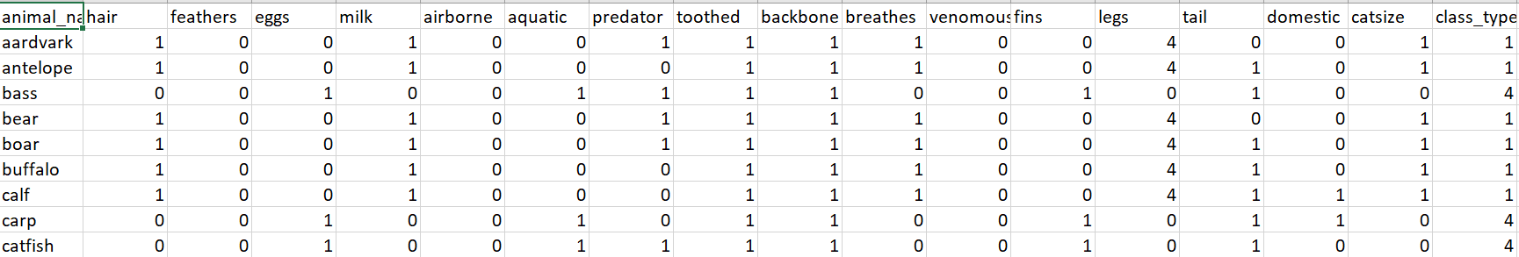
Pretreatment
Merge class.csv and zoo.csv by class type.

Slide 4
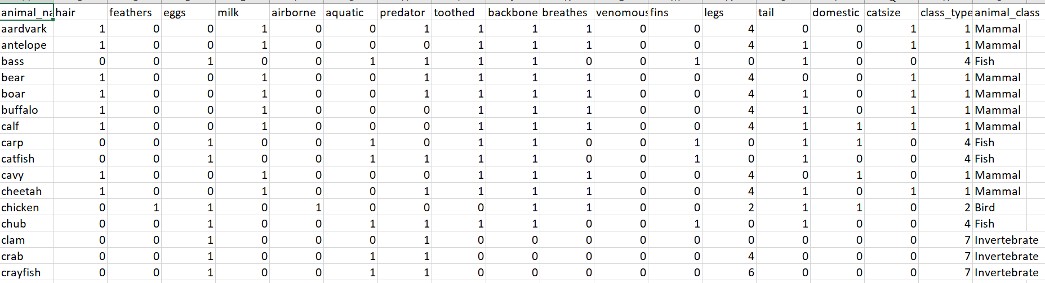

Slide 5
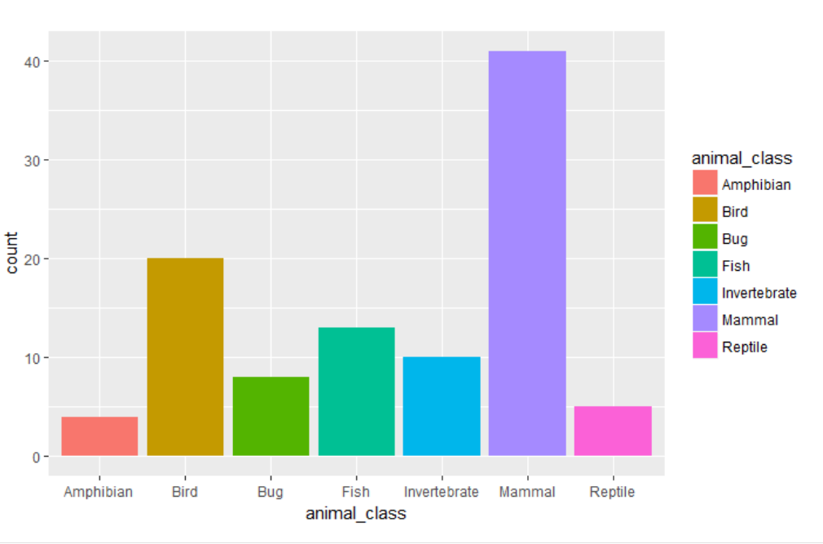
Main features
The predicted variable is categorical.

Slide 6
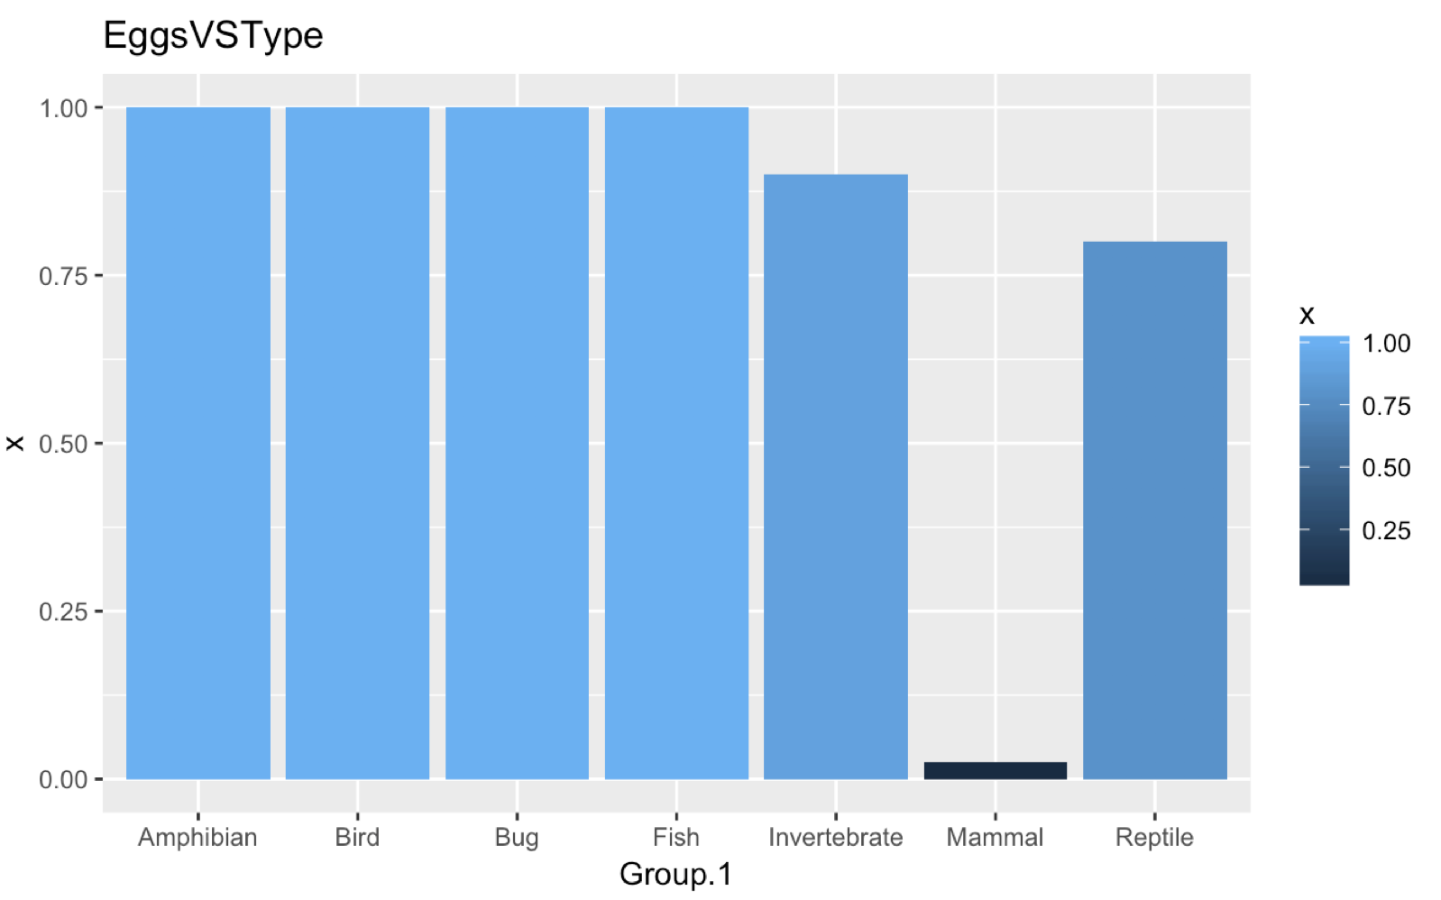
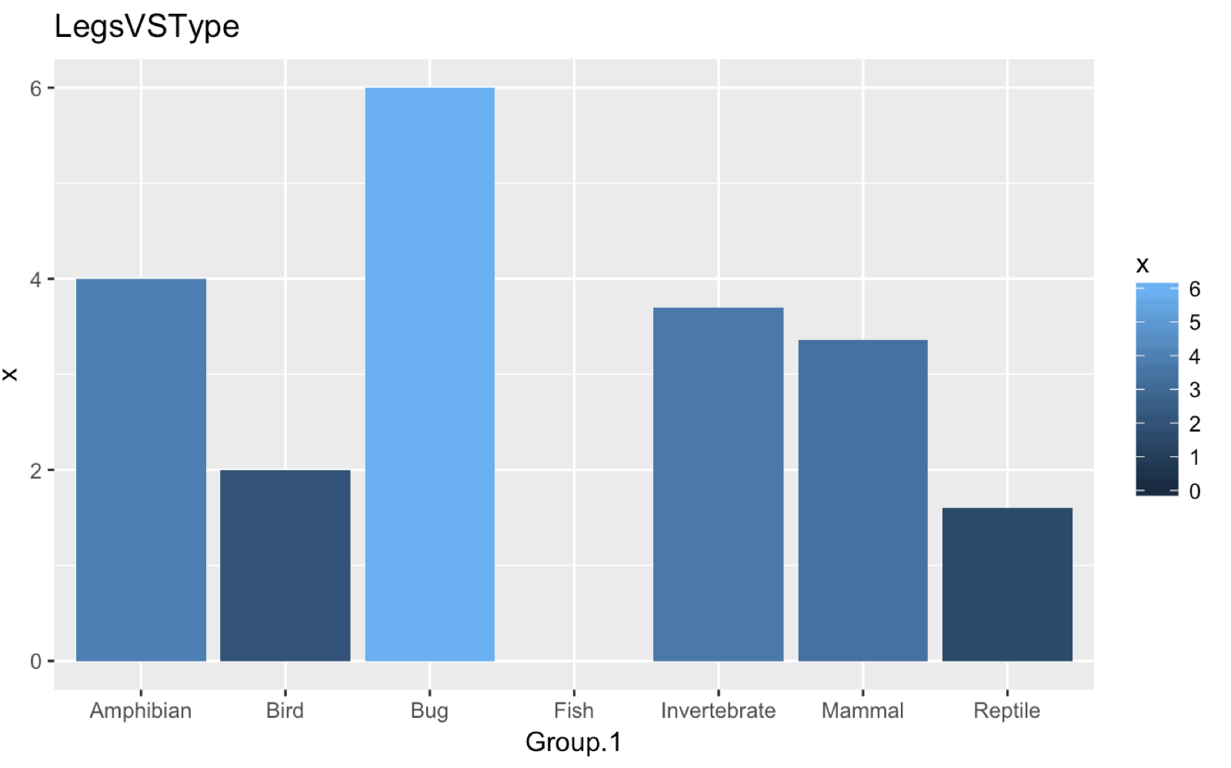
Main features

Slide 7
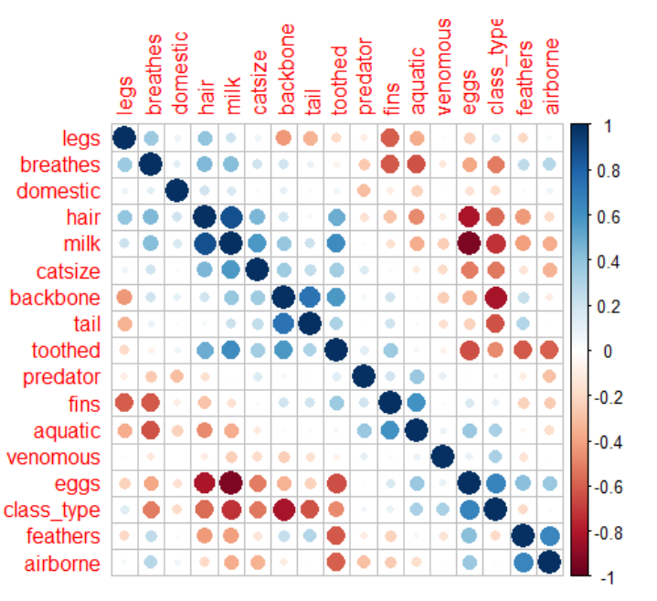
Main feature
Rows: 101
Variables: 15 response variables
Correlation

Slide 8
Research question
How to reduce the dimension of variables (PCA)
Exploring how many types of animals assuming that we don’t know the animal type
(EM)
How to predict the animals type
(Naïve Bayes)
Notes:
Assume don’t know how many animals type in the data
and still contain all original information?

Slide 9
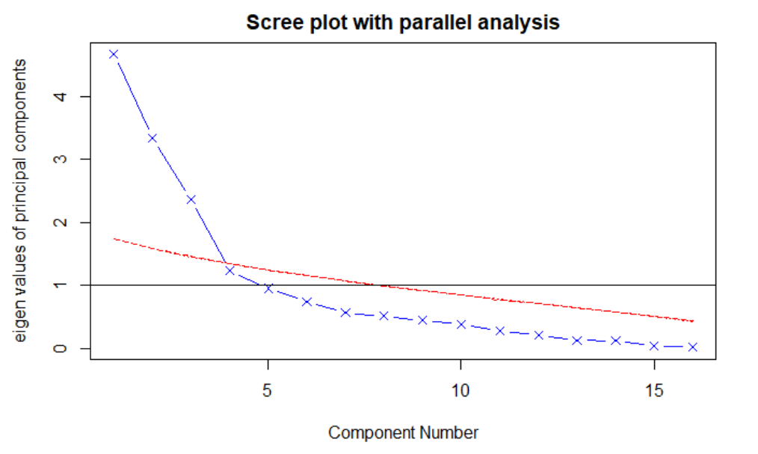
Reduce dimension Step1 : Find the number of components
Three Criteria:
1. The Kaiser–Harris criterion
2. The Cattell Scree test
3. The Parallel Analysis
fa.parallel( ) and abline( ) functions

Slide 10
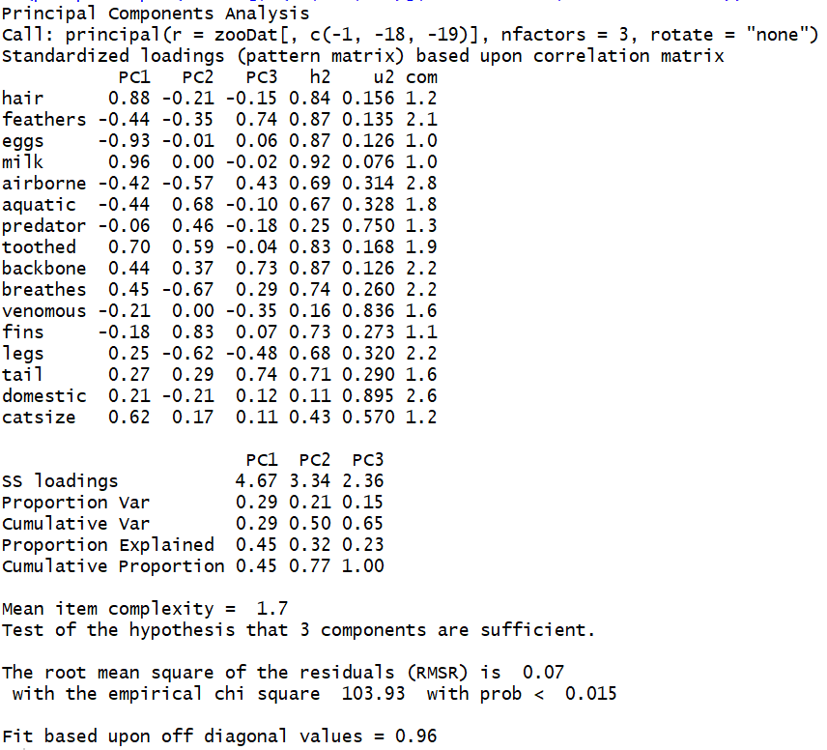
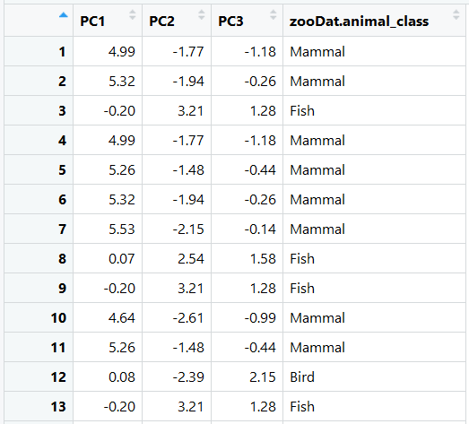
Step2 : Getting loadings and convert to principle components data
Loadings
Convert
$$PC_{i}=a_{1}X_{1}+a_{2}X_{2}+…+a_{k}X_{k}\text{,} i=1,2,…,k$$

Slide 11
EM method
iterative method to find maximum likelihood of parameters in statistical models
Maximum Likelihood Estimation:
the likelihood of θ as the conditional probability of the dataset D :
The goal of maximum likelihood estimation is to choose the parameters θ that maximize the
likelihood:
EM is an two-step iterative approach: Expectation (E) step and Maximization (M) step

Slide 12
EM method
Assume k clusters
Algorithm:
Initialize parameters and for each cluster i
(2) E-step: Compute the cluster posterior probabilities
(3) Use to re-estimate parameters and for each cluster i
(4) Repeat E and M steps until satisfied some certain criterion.
$$\left.P(C_{i}|x_{j}\right)$$
$$\left.P(C_{i}|x_{j}\right)$$

Slide 13
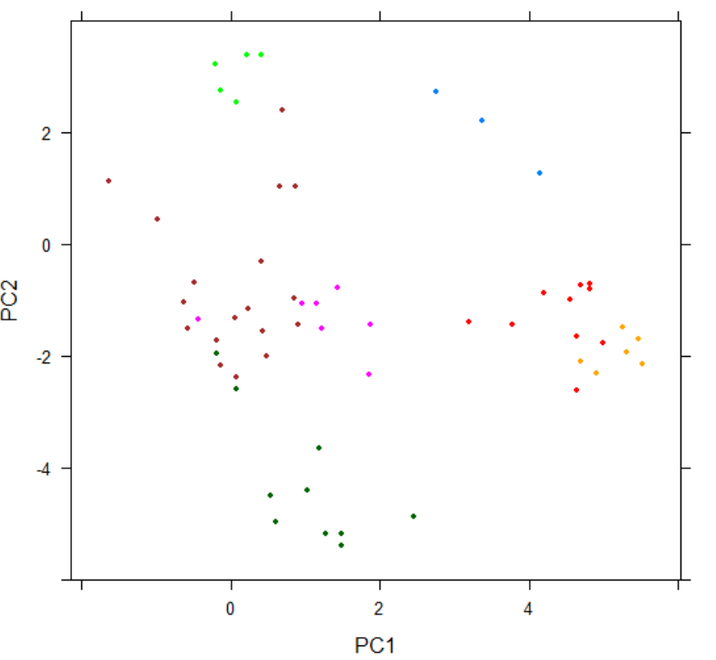
EM Application
Begin with the assumption that the first 15 instances are in cluster 1, next 15 in cluster 2, etc.
Initialization: means computed by data in initial clusters, covariance matrix: diagonal is 1, each
prior .
The stop criterion: the Euclidean Distance between the old means and the new means < 0.001.

Slide 14
Test the performance of EM algorithm
 | T1 | T2 | T3 | T4 | T5 | T6 | T7
C1 | 4 | 0 | 0 | 0 | 0 | 0 | 0
C2 | 1 | 0 | 2 | 0 | 4 | 0 | 1
C3 | 0 | 0 | 0 | 0 | 0 | 8 | 5
C4 | 15 | 0 | 0 | 0 | 0 | 0 | 0
C5 | 21 | 0 | 0 | 0 | 0 | 0 | 0
C6 | 0 | 0 | 0 | 13 | 0 | 0 | 0
C7 | 0 | 20 | 3 | 0 | 0 | 0 | 4
External validation measures employ criteria that are the actual class labels for each point
Purity : 1/101*(4+4+8+15+21+13+20)=0.84
F-measure : 0.67

Slide 15
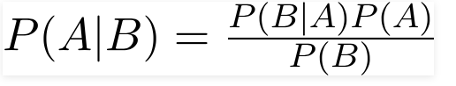
Naïve Bayes
1. assume: each response variables is independent and they contribute equally to the animal type
2. Bayes Theorem
3. P(A) is the number of instances with label c1/ total rows in the dataset
4 . P(B|A) can be estimate by density function
Notes:
Calculate the probability for points in class 1
p(A) is the number of instances with label c1 / number of rows
P(B|A) is the P(x|c1)* P(x|c2) …., because assume each variables is independent
P(x|c1), when x is numeric, apporimately equal to the density function of x
P(B) is the probability of x = B

Slide 16
Algorithms
Using training data
Step1: calculate the mean and variance of each clusters
Step2: calculate priors probability: number of instances with label c1 / number of rows
Using testing data
Step3: calculate the density to see which data points belong to which cluster

Slide 17
Naïve Bayes
Divide zoo dataset to train and test data
60% is train (60)
40% is test (41)
Apply Algorithms
Accuracy: 90%

Slide 18
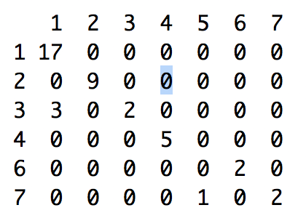
Predict Result
Predicted Class VS Actual Class
(Vertical Label: actual value,
Horizontal Label: predicted value)
the accuracy of 1 is 1
the accuracy of 2 is 1
the accuracy of 3 is 0.4
the accuracy of 4 is 1
the accuracy of 5 is 0
the accuracy of 6 is 1
the accuracy of 7 is 0.6666667
the overall accuracy is 0.902439

Slide 19
Questions?

